Slide 1



VOIS Innovation
Marathon 2.0

Slide 2
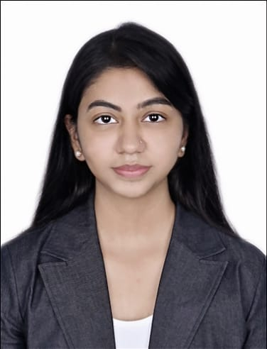

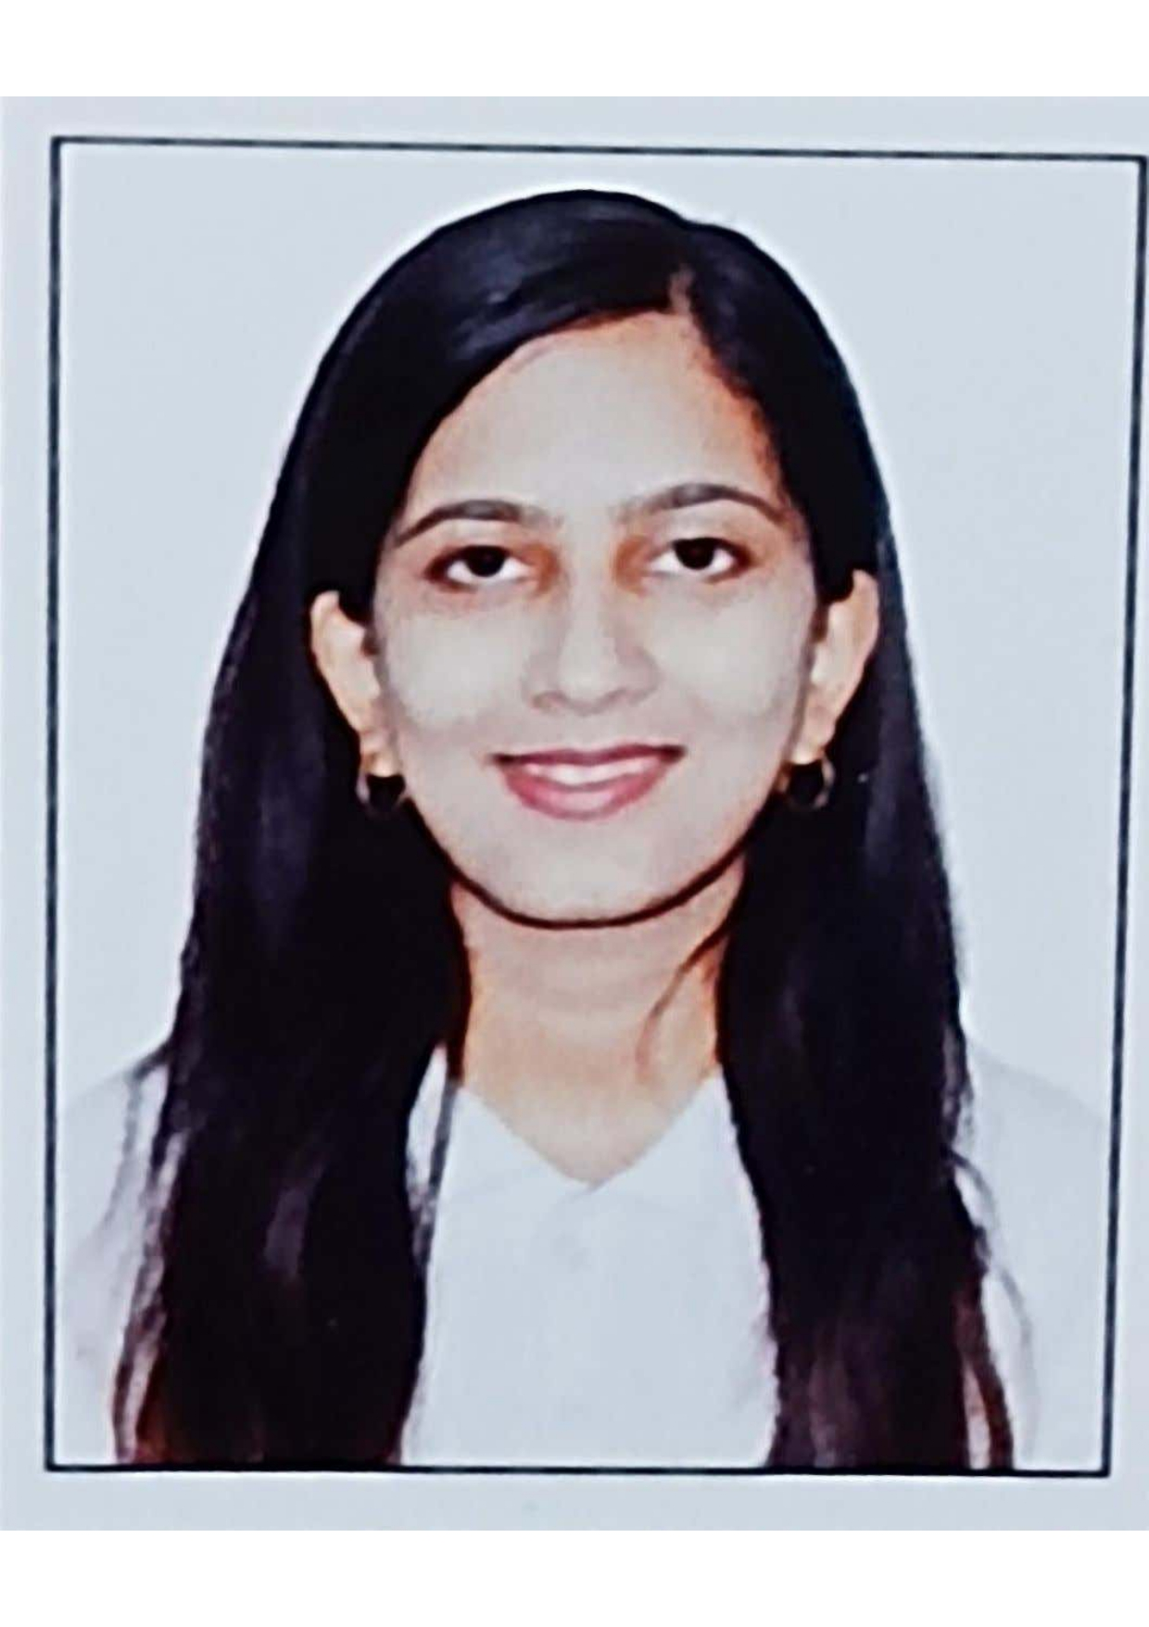
AI Powered Voice Anti-Spoofing Detection System
Team No. 32
Team lead, Chetanya Bhadravati, AIML
Insert your professional photo
Symbiosis Institute Of Technology, Pune & Maharashtra
Akshaya Suryavanshi, AIML

Slide 3




Problem Statement
AI Powered Voice Anti-Spoofing System
The Challenge: Voice-based authentication and communication systems are increasingly vulnerable, as organizations and users often struggle with:
AI-generated voice fraud – realistic cloned and deepfake voices that can impersonate genuine users and bypass traditional security systems.
Authentication reliability gaps – conventional voice verification techniques failing to distinguish between real and synthetic voice.
Unreliable detection methods – lack of robust solutions that work consistently across noisy, real-world environments.
Rapid evolution of spoofing techniques – continuous advancements in AI voice generation tools making detection more challenging.
Without a reliable and intelligent voice anti-spoofing system, organizations face increased risks of identity theft, financial fraud, unauthorized access, and loss of trust in voice-driven applications.

Slide 4
Need of Project
Rapid advancement of AI voice cloning tools
Increased adoption of voice biometrics in authentication
Growing incidents of voice-based fraud and impersonation
Absence of lightweight, deployable anti-spoofing systems
Demand for secure AI-driven voice authentication solutions

Slide 5

Proposed Solution
We propose an AI Powered Voice Anti-Spoofing System that automatically detects whether an audio sample is genuine or spoofed.

Slide 6
Solution Overview
Our solution follows an end-to-end AI pipeline:
Audio input is collected from users
Audio is converted into Mel-Spectrograms
Feature embeddings are extracted using a pre-trained model
An Artificial Neural Network classifies the voice
Output is displayed as Real Voice or Fake Voice

Slide 7

Technology used
1
Python (TensorFlow / Keras)
2
YAMNet (Transfer Learning)
3
Mel-Spectrogram for feature extraction
4
Artificial Neural Network (ANN)
5

Slide 8
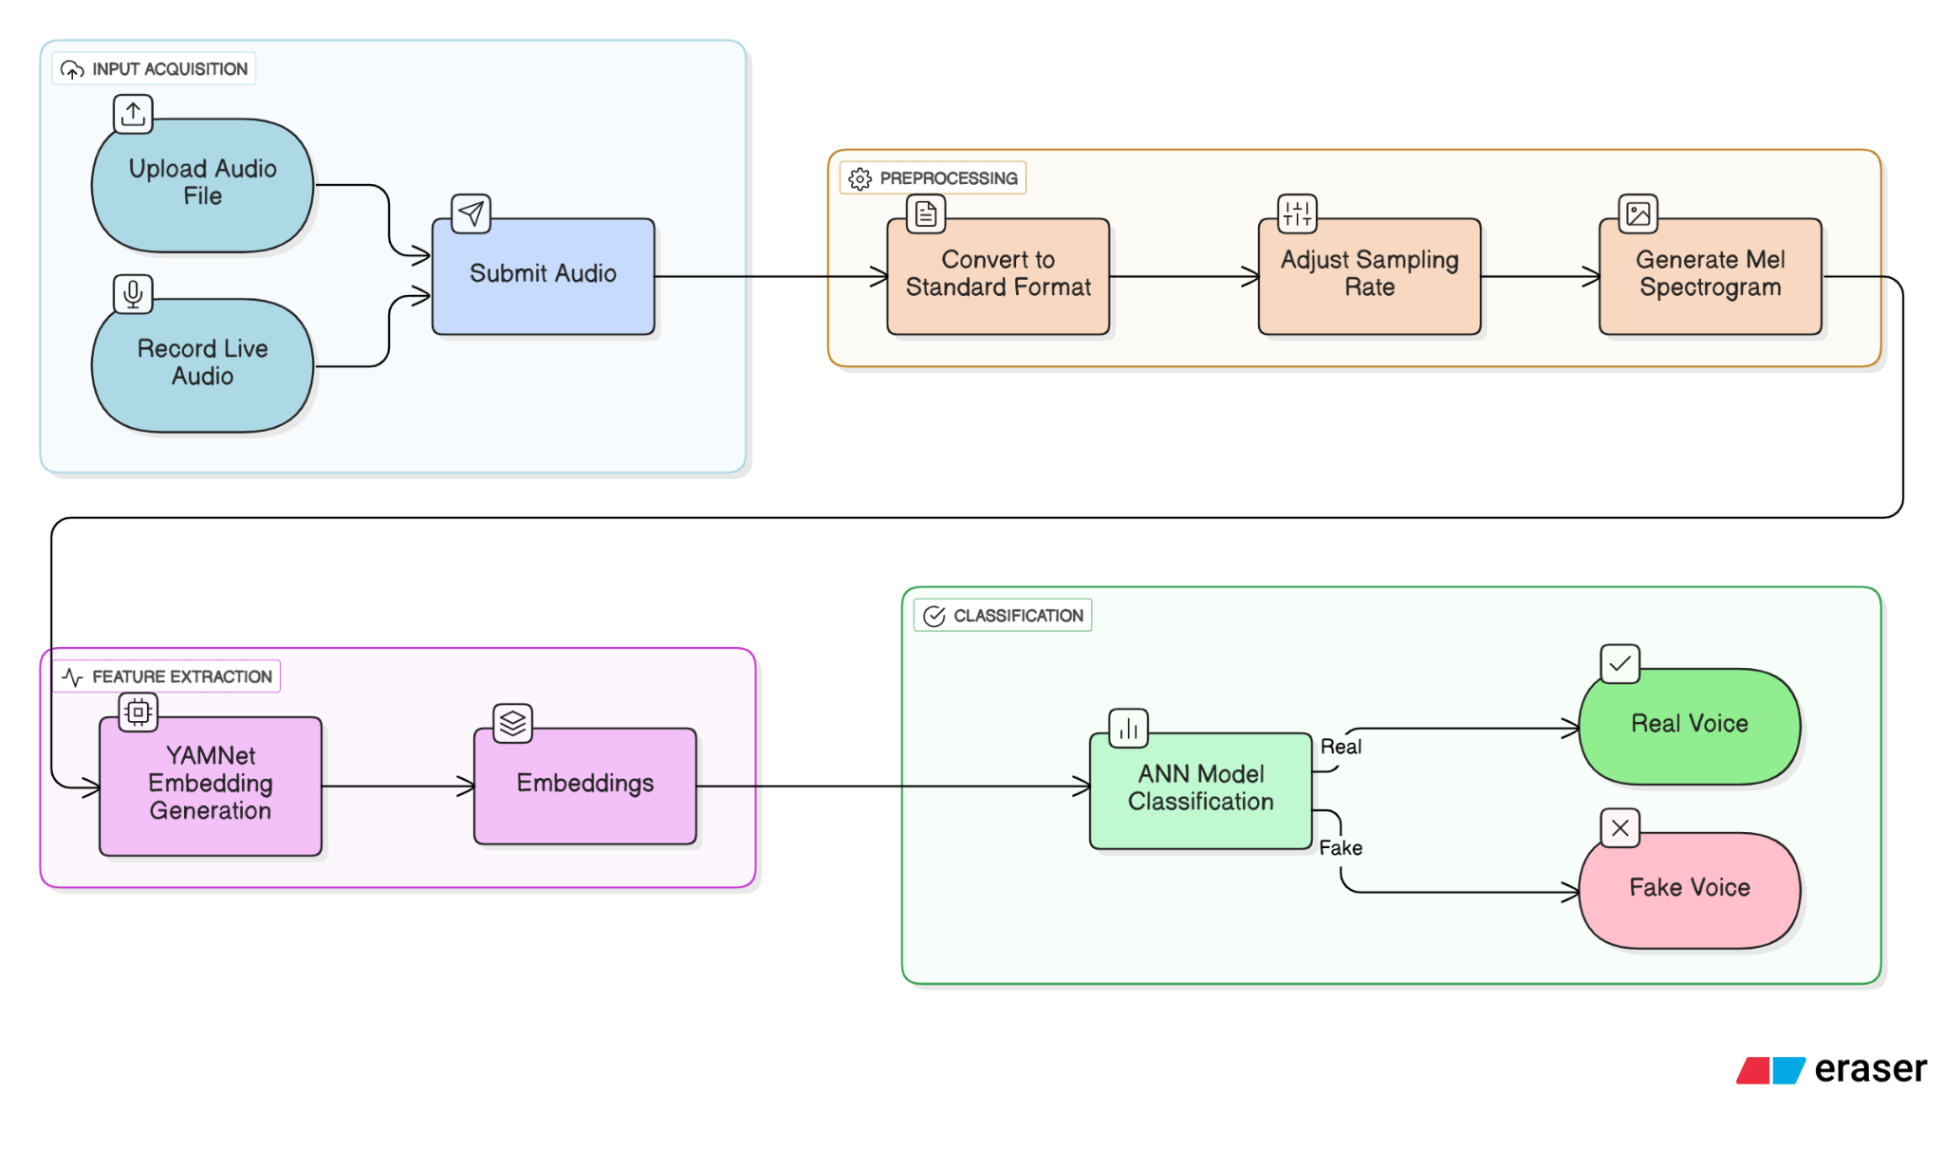
Technical flow diagram -

Slide 9
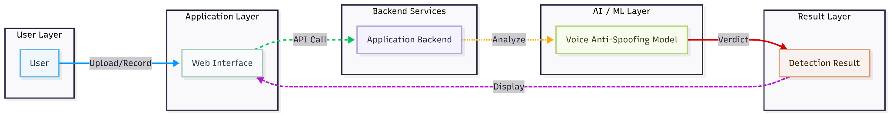
Architecture Blueprint

Slide 10
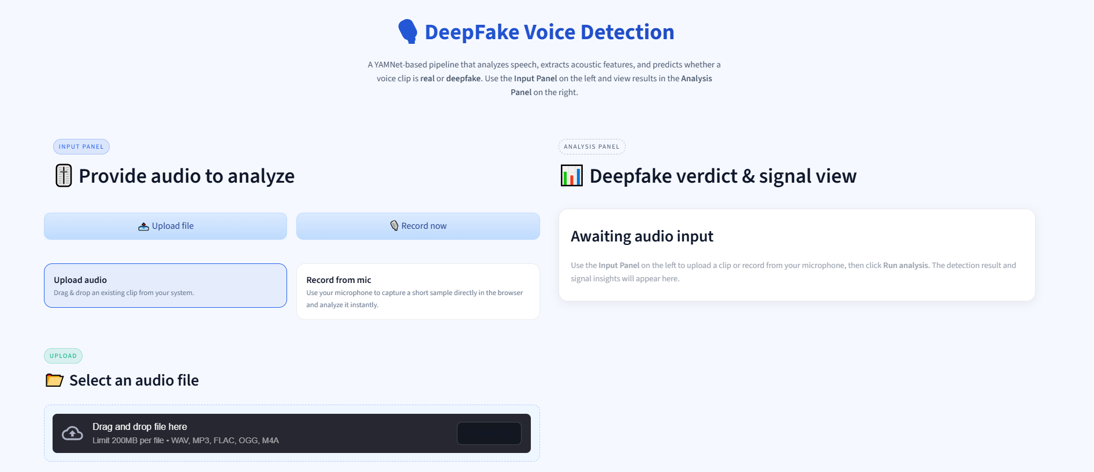
Screenshots of the project -

Slide 11
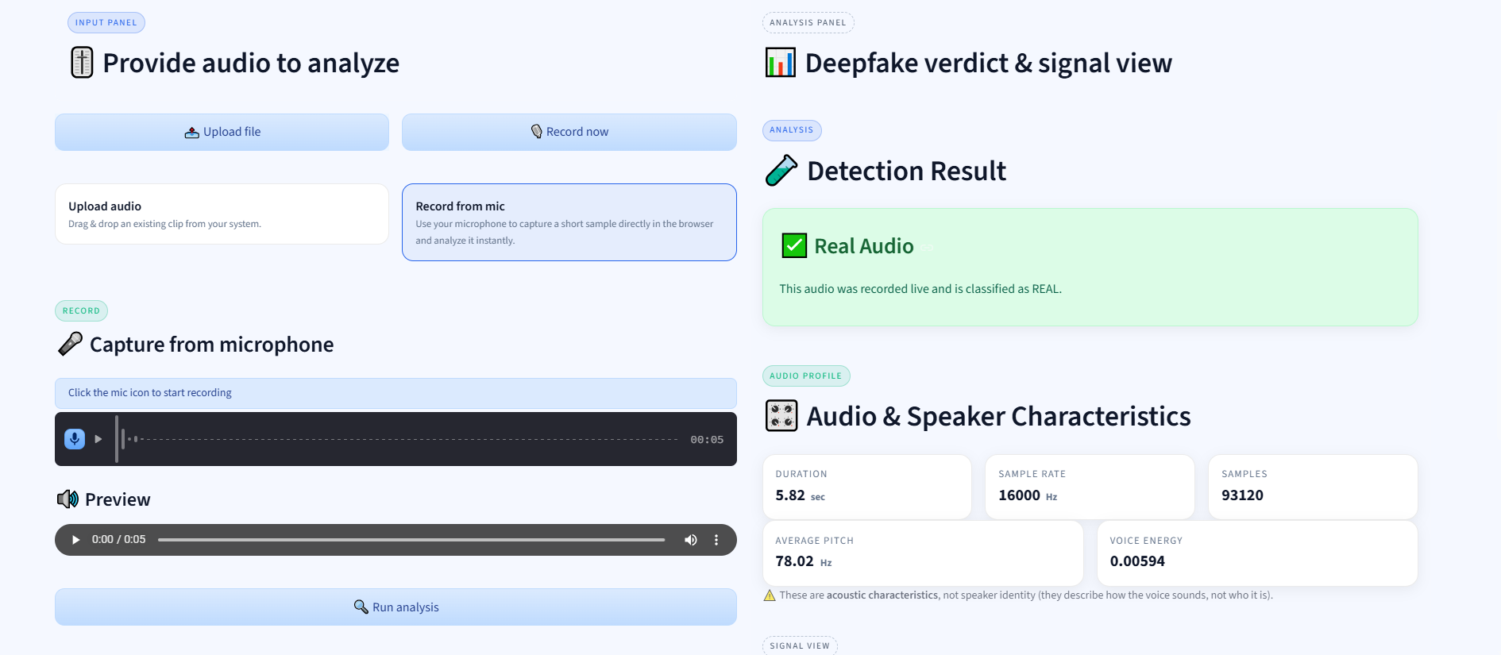
Screenshots of the project -

Slide 12
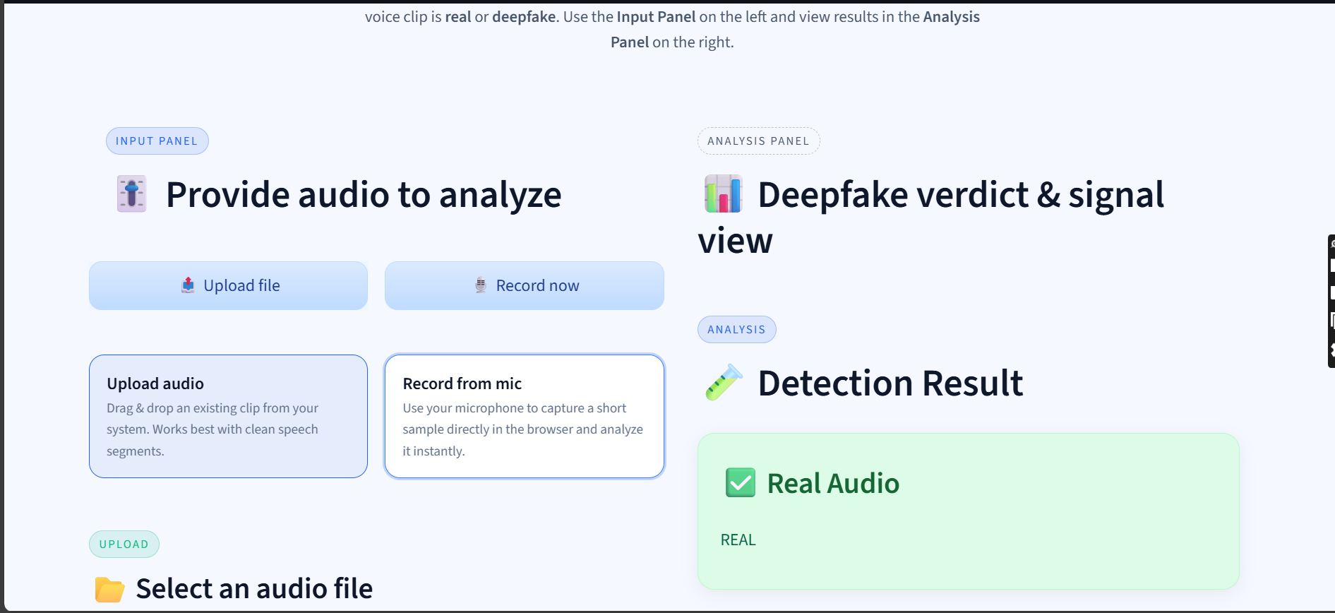
Screenshots of the project -

Slide 13
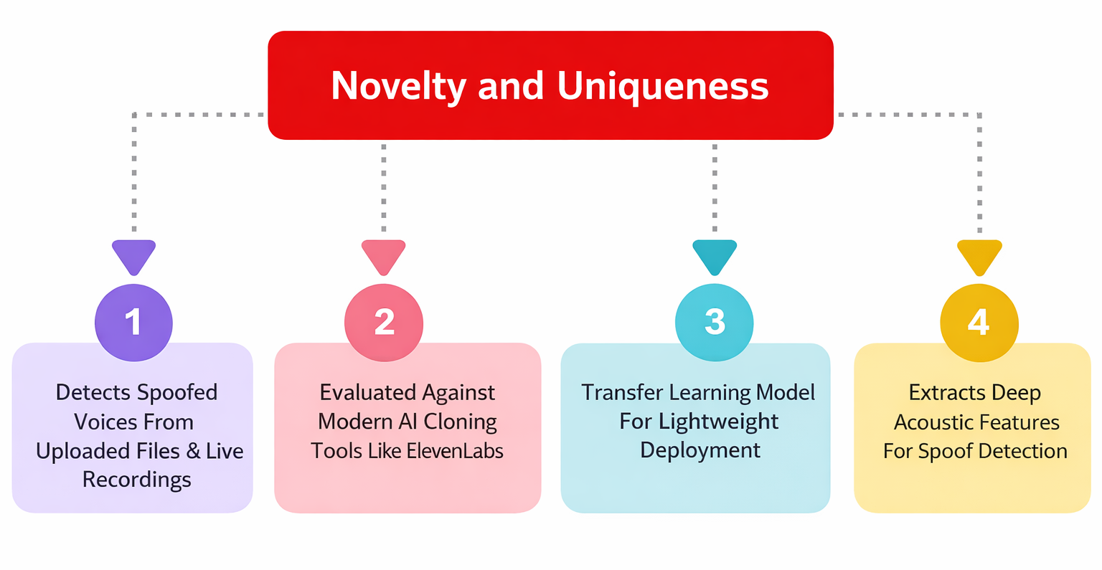

Slide 14
Git Hub Link
https://github.com/akshaya3107/AI_Powered_Voice_Antispoofing_Detection

Slide 15
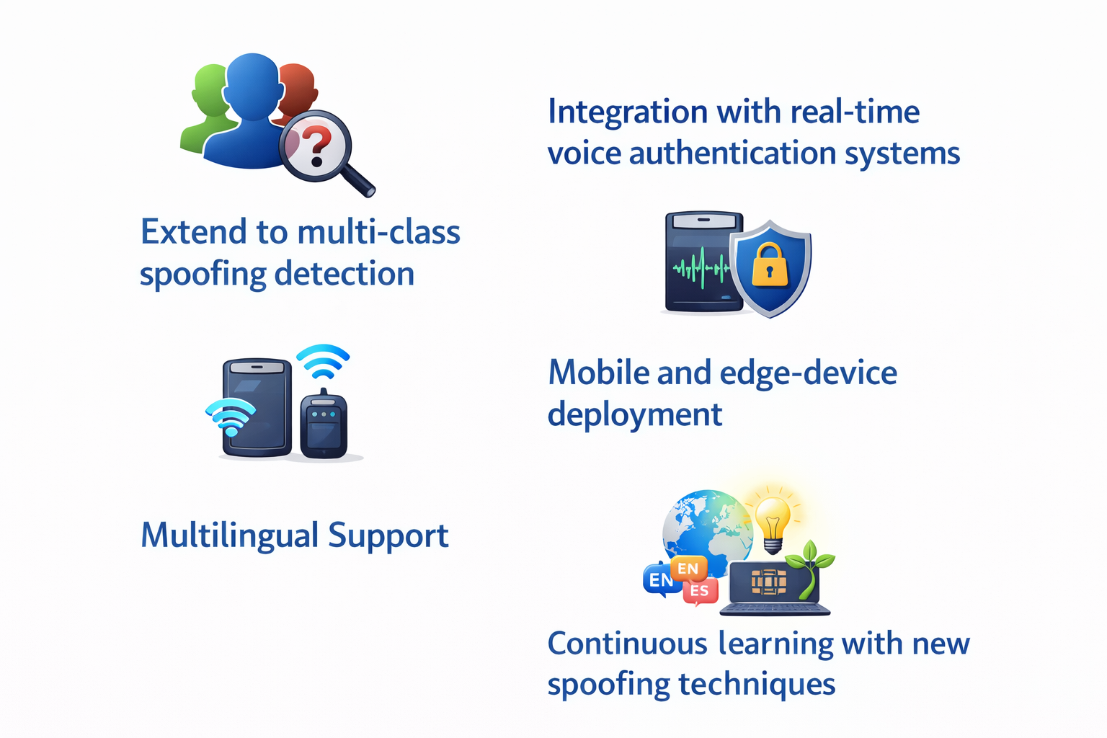
Future Scope

Slide 16
Bank Details
Full Name (as per bank records): | Bank Name | Branch Name | Account Number | Account Type (Savings / Current) | IFSC Code
Chetanya Mahesh Bhadravati | Bank of Maharashtra | B.T.Kawade Road | 60487433147 | Saving | MAHB0001718
Prakash Suryavanshi | Axis Bank | S.B.Road | 921010009325774 | Saving | UTIB0000315

Slide 17
Thank You

